Slide 1


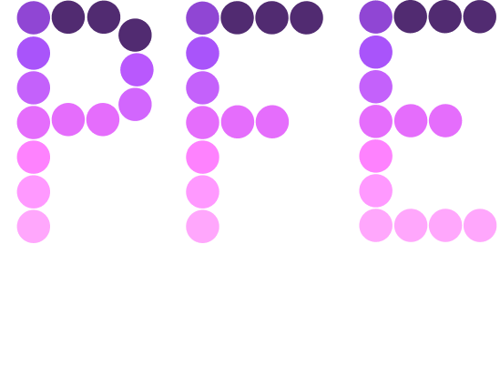

Python Workshop

Slide 2
Concepts To Be Covered
Variables
Looping
Operators
Iterables
Data Types
Functions
Conditional Statements
Exception Handling

Slide 3
Python is a popular high-level, general purpose language known for its readability and exceptional versatility in different domains of science and engineering.
Let’s break down what this definition means:
High-Level: Syntax is much closer to human readable langauge (English), when compared to C or Java
General Purpose: Not restricted to specific applications, can be used for scripting a wide variety of tasks, from web development to machine learning
Introduction

Slide 4

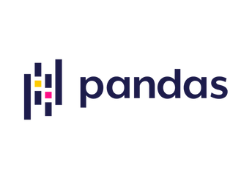
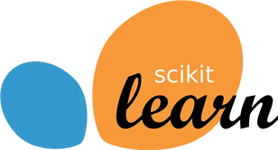

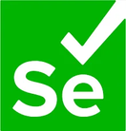
Python, being high-level, abstracts away (or simplifies) a lot of work for programmers. This makes it much simpler to understand, and a lot harder to make critical mistakes.
With its innumerable libraries, Python allows for swift development of software in various domains, including:
Machine Learning and Artificial Intelligence:
Web Development Data Scraping
Introduction

Slide 5
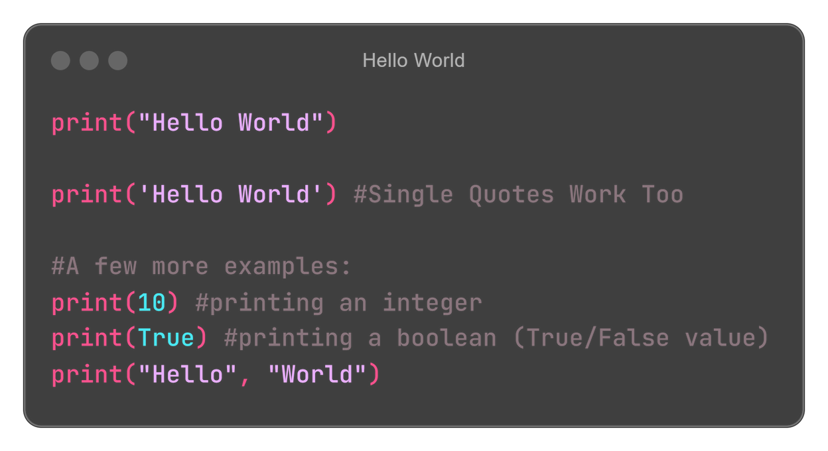
Let’s start with the simplest of all tasks, printing “Hello World”
Your First Python Script

Slide 6
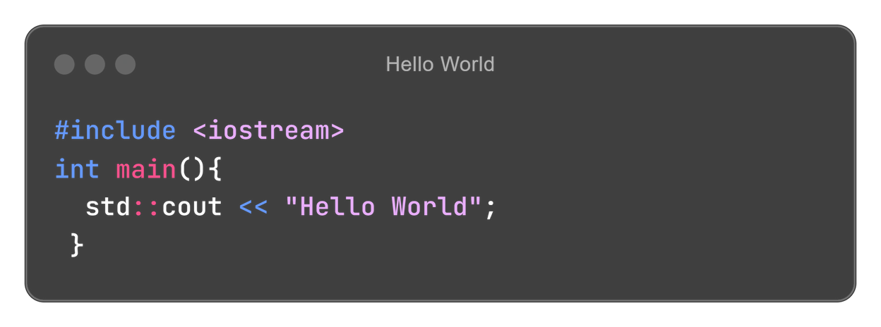
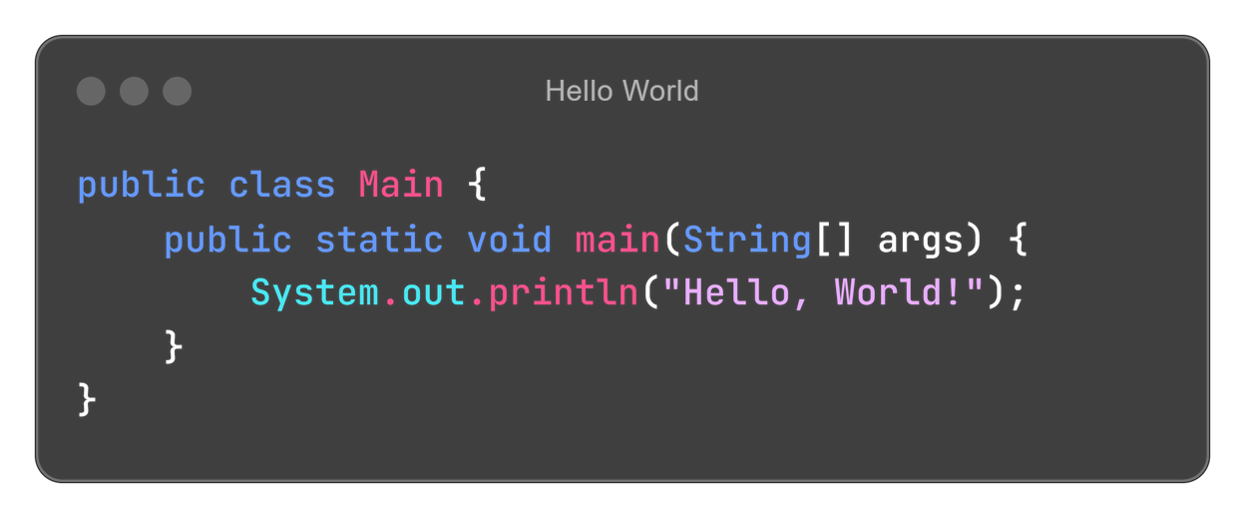
Here’s how the same Python code compares to its counterparts
(C++ and Java)
Comparison with other languages

Slide 7
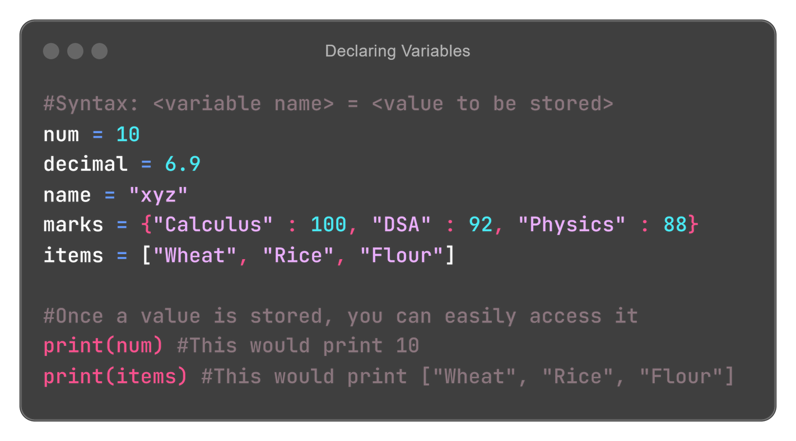
In any programming language, a variable refers to the name given to a part of computer memory (RAM) to store a specific value.
In simpler terms, if you wish to store/remember a value in your program, you’ll use a variable.
A variable can store any value, from integers and strings to even user-defined, custom data (classes).
Variables

Slide 8
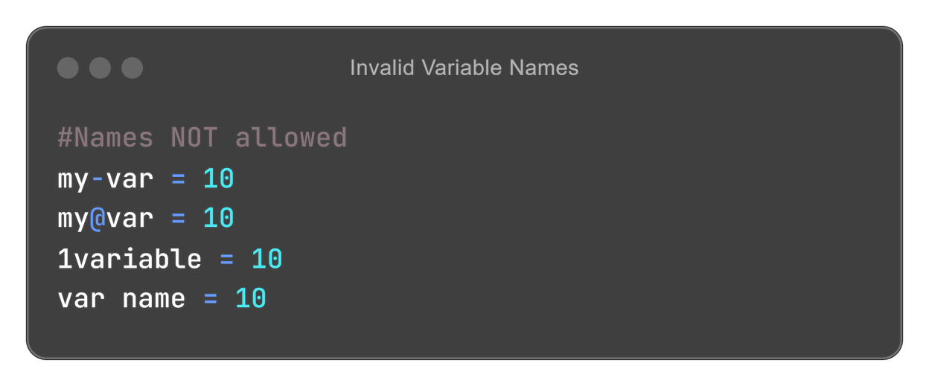
Naming Rules
A variable name must be unique within its scope, i.e. no 2 variables should share the same name.
Variable name cannot be a Python keyword, i.e. you cannot name a variable as ‘print’, ‘int’, ‘list’, ‘def’, and so on.
Only letters, numbers, and the underscore character are allowed within names (eg. myVar, my_var, var1).
Although numbers are allowed, a name must not begin with a number.
Variables

Slide 9
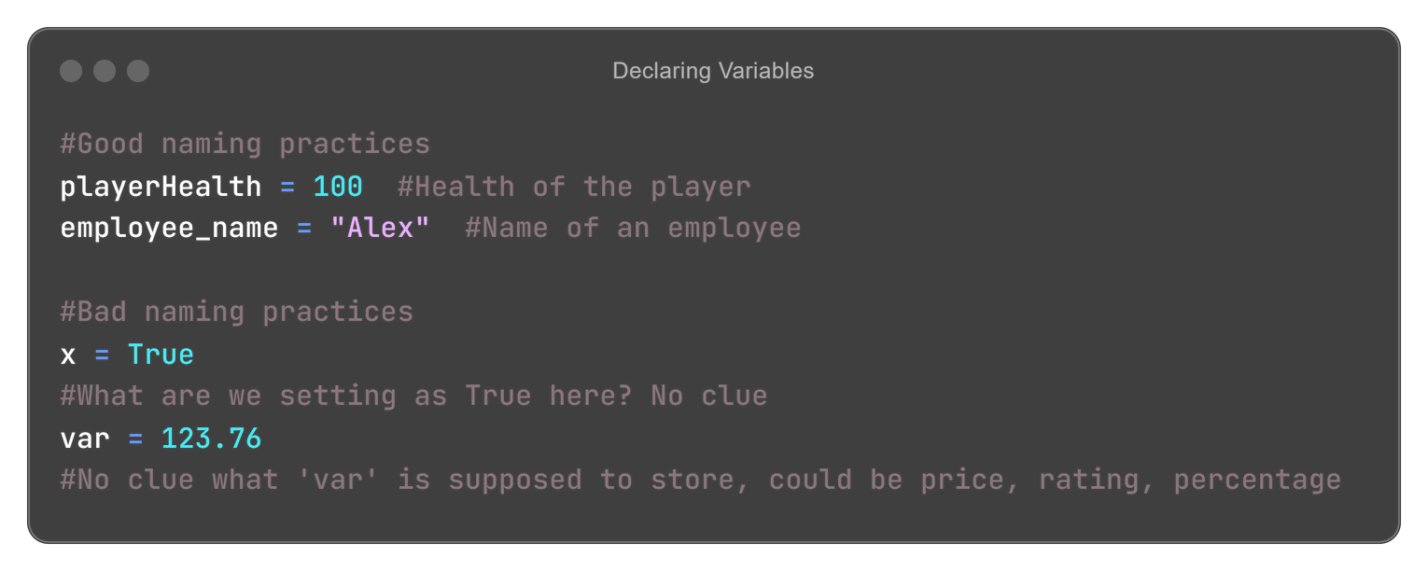
Why we need variables
Variables spare us from remembering the actual memory address of a value we’re storing. Without variables, we’d need to remember the address of each and every value we wish to store for our program
Good Practices
Names should be self-explanatory: Instead of naming variables as ‘x’, or ‘myvar’, it is important to name them something which can be understood intuitively.
Variables

Slide 10
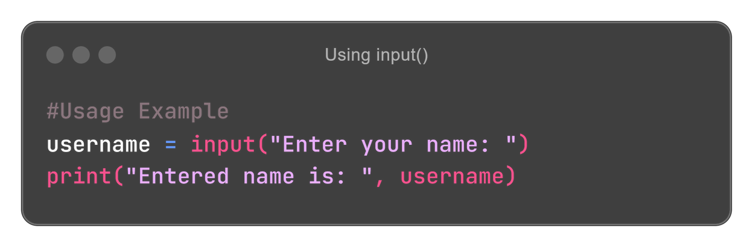
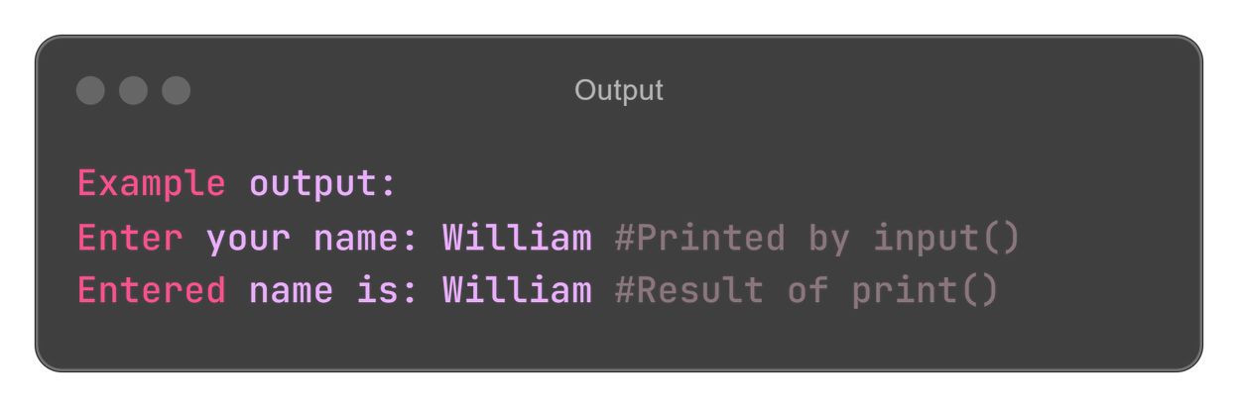
The input() function is a built-in (internally defined) function in Python used to take input from the user.
Note: By itself, any value entered into input() is stored as a string (str). So, even entering something like “123” into the input() prompt will give you “123” as a string, rather than 123 as an integer.
input()

Slide 11
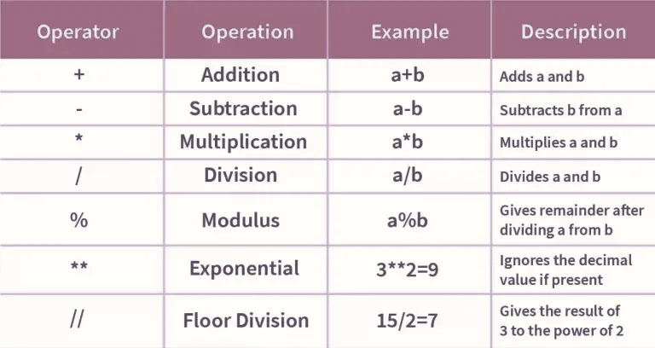
An operator is simply a symbol that defines what action is to be done between 2 or more variables (can also be for a single variable).
Works exactly like mathematical operators, so something like:
print(1+2) would print 3
Operators

Slide 12
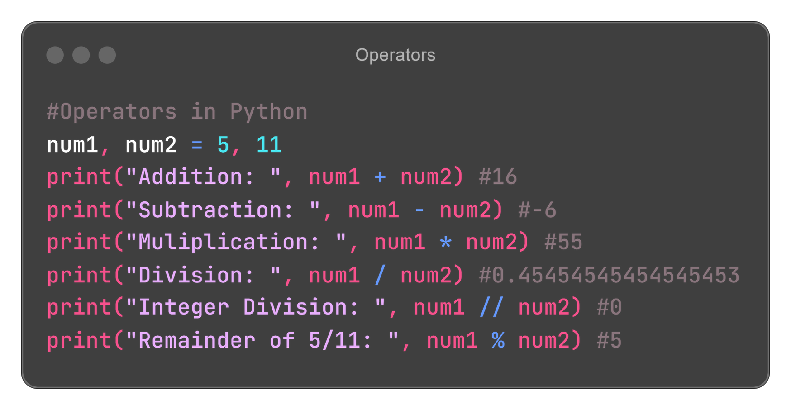
Operators

Slide 13
Definition: The data type of a variable specifies the type of information/data that it can store. It also restricts the types of operations that can be performed on the variable.
int: Represents an integer (no decimal point), such as 100, 69, -1243, etc.
float: Represents a decimal value, such as -6.9, 42.37, 0.11, 0.000012, etc.
bool: Represents a True/False (1/0) value
str: Represents a string, such as “John”, “123”, “True”, “Python”. All strings are enclosed in quotes.
Data Types

Slide 14
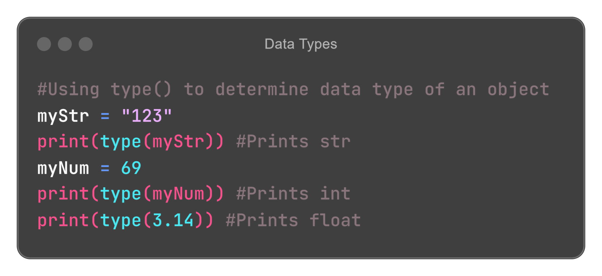
Identifying data types

Slide 15
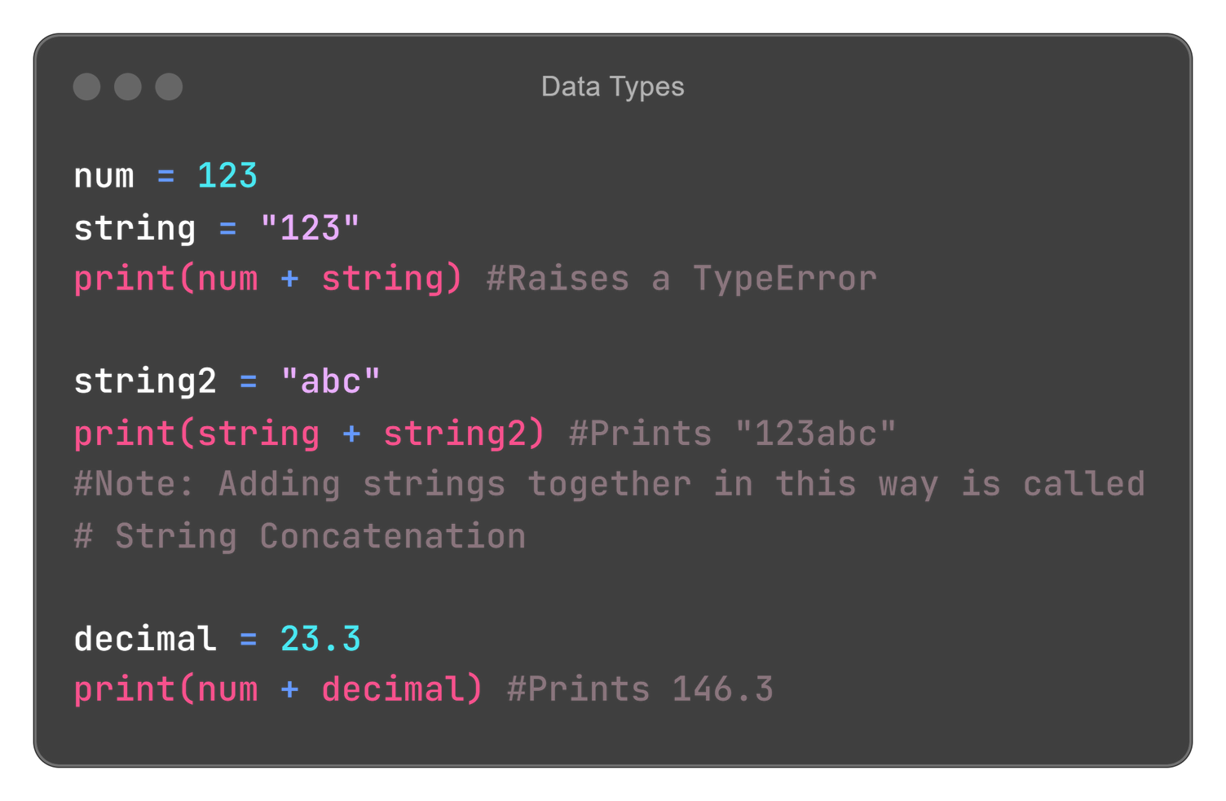
Data type related issues

Slide 16
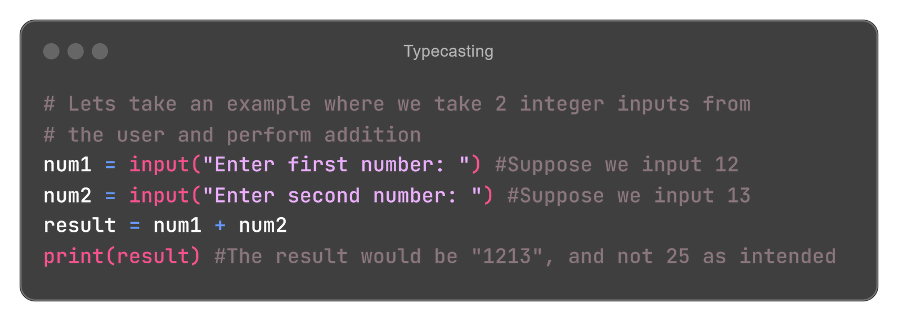
Changing the data type of a variable is called type casting.
Often times, the language itself would change data types whenever needed (such as changing an int to a float, or a bool to an int).
However, there are many cases where we might need to explicitly change the datatype of a variable
Type Casting

Slide 17
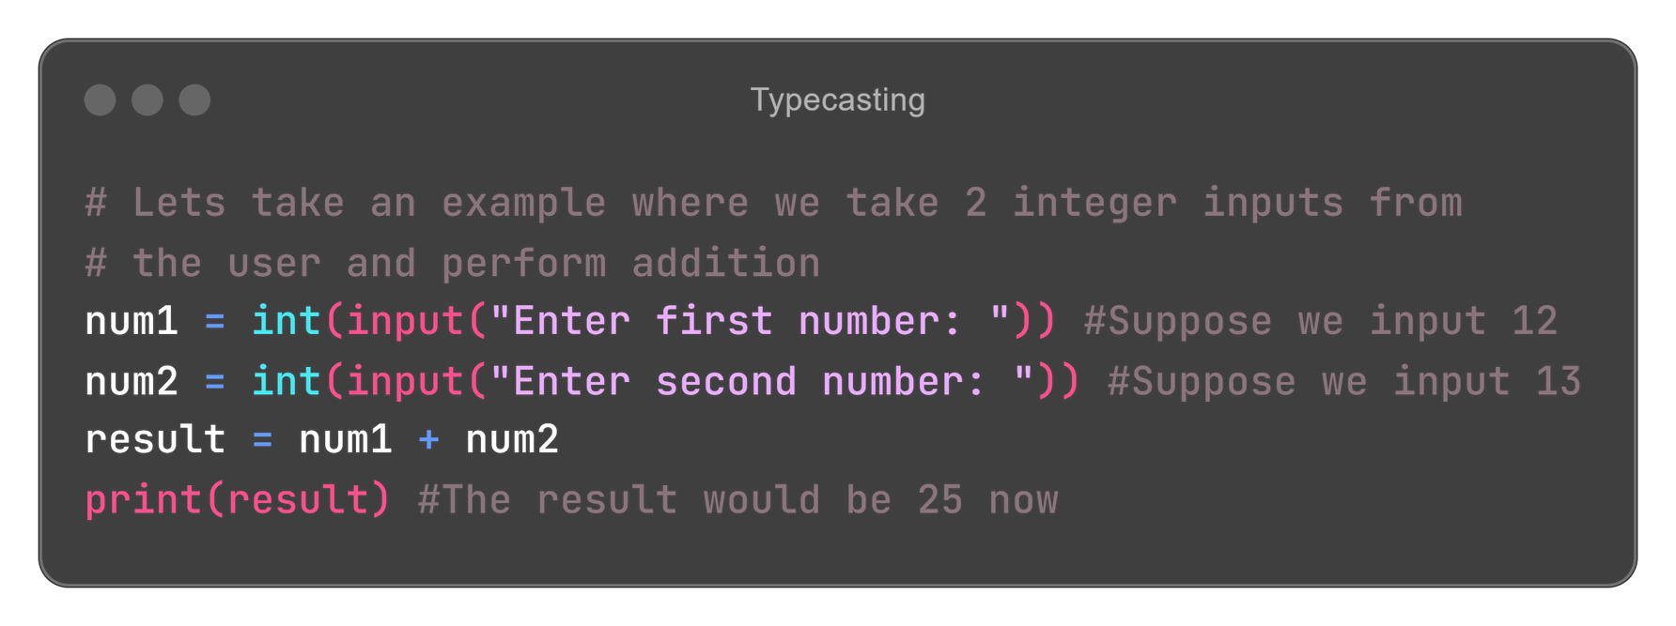
Typecasting
As we can see, we unintentionally performed string concatenation instead of normal addition.
This, obviously, is because the input() function returns a string, no matter what we type into it.

Slide 18
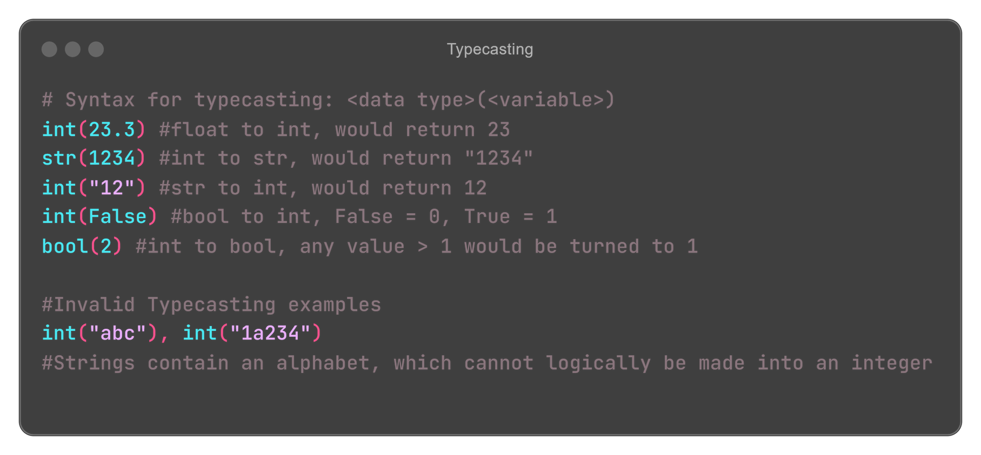
Typecasting
This technique is called explicit typecasting, where the developer specifies the change of a data type.

Slide 19
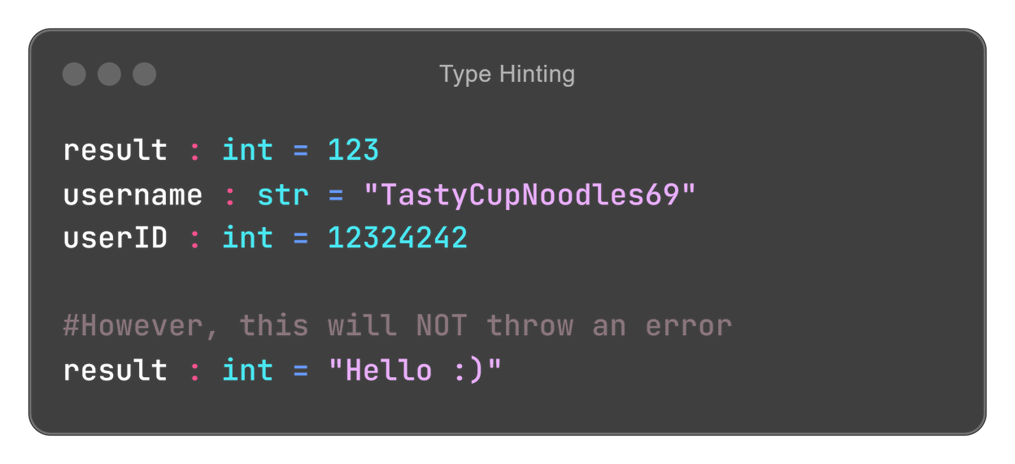
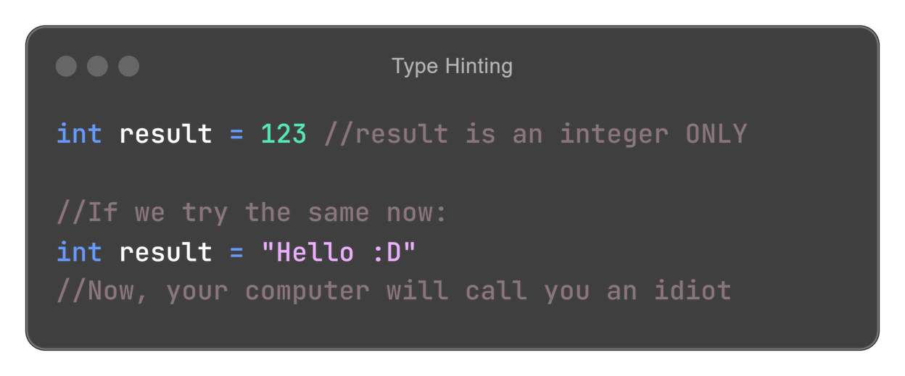
Type Hinting
Type hinting is a technique in Python to specify the data type that a variable is meant to be.
Note: Unlike C/C++/Java, type hinting does NOT specify the actual data type of a variable, rather it shows the expected type of a variable.
<- Python
C++ ->

Slide 20
A conditional statement is used to check something (a condition) and make a decision depending on whether the condition is True or False.
Think of it like this: You’re deciding whether to go outside. You look out the window:
If it’s raining, you’ll take an umbrella.
Else (otherwise), you’ll just go outside without an umbrella.
Another example could be:
if a student scores more than 85, they get an A+
else if they score between 75-84, they get an A
else if they score between 65-74, they get a B+
and so on
Conditional
Statements

Slide 21
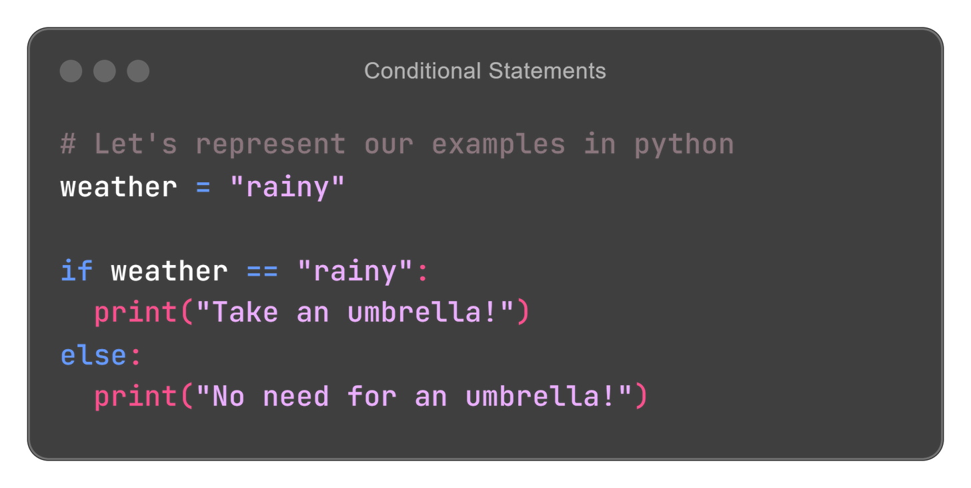
Conditional Statements
Checking for conditions: We use comparison operators, to check for equality.
Is Equal: The “==” operator is used to check if two values are equal (a == b, would be True if a and b are equal, False otherwise
TEST
CONDITION
True
False
LOGIC FOR IF BLOCK
LOGIC FOR ELSE BLOCK

Slide 22
1ST CONDITION
LOGIC FOR 1ST CONDITION
2ND CONDITION
LOGIC FOR 2ND CONDITION
Conditional Statements
We can also have any number of conditions to check. This is known as a ladder, since the way we check for the conditions one by one represents descending from a ladder, one step (condition) at a time.
N CONDIITON
LOGIC FOR NTH CONDITION
ELSE
LOGIC TO BE DONE IF ALL CONDITIONS ARE FALSE

Slide 23
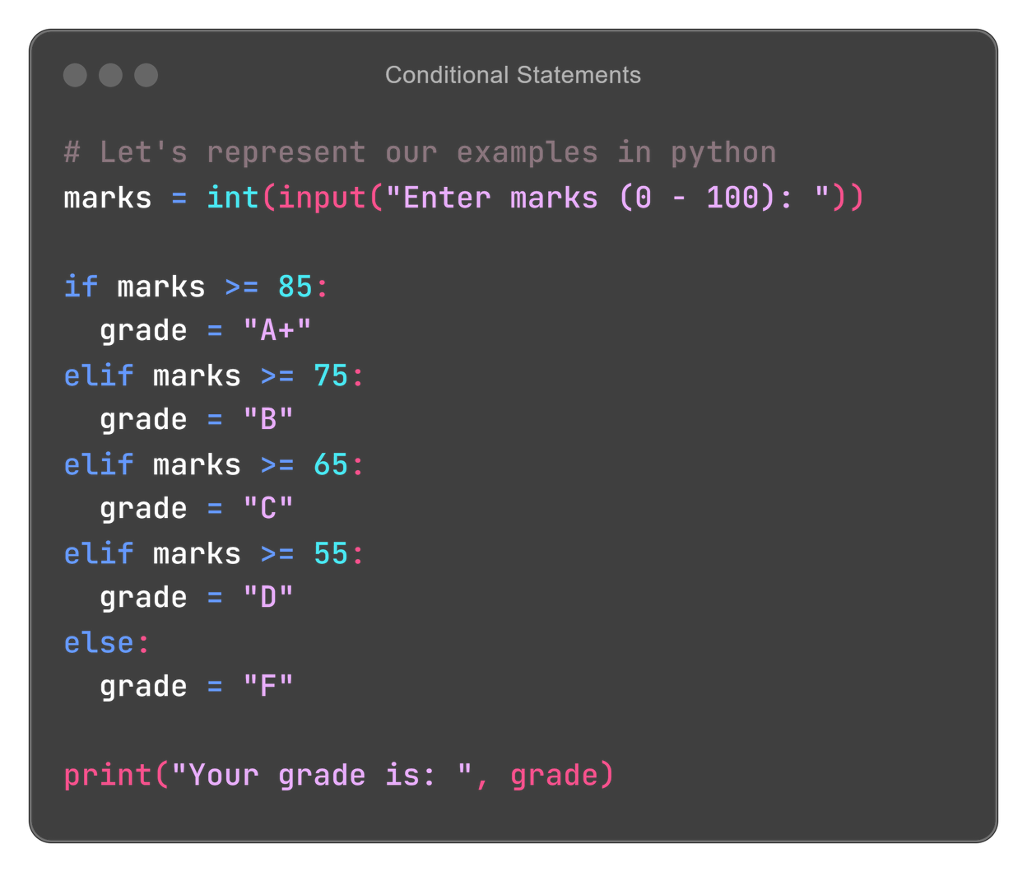
Conditional Statements
To check for multiple conditions, we use the elif keyword.
elif is just short for “else if”. This can be seen in the Python code for our student grade calculator.
Other comparison operators:
Greater Than: The ‘>’ operator. So, 5 > 4 would return True
Lesser Than: The ‘<’ operator. So, 4 < 5 would return True
We can also combine these 2 operators with the “=” sign, to get >= (Greater than or Equal To), and <= (Lesser Than or Equal To)

Slide 24
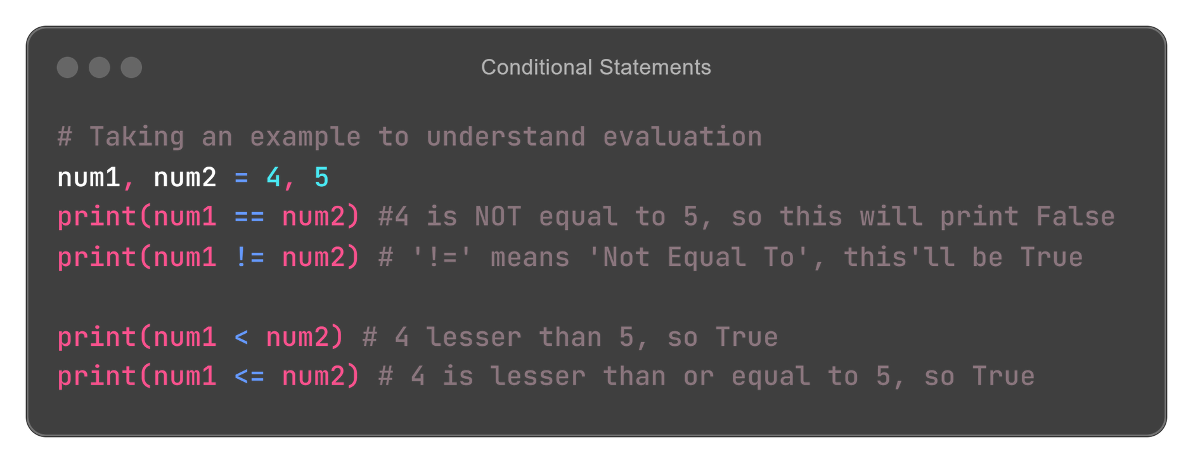
Conditional Statements
Booleans are particularly helpful when it comes to conditional statements.
No matter what a condition might be, in the end it is evaluated (broken down) to either True or False.

Slide 25
An iterable is simply an object over which you can loop over (iterate).
In the simplest terms, an iterable represents a collection of items, like how a shopping list contains a collection/group of items you wish to buy.
Python has a rich collection of iterable data types, including:
List: [1,2,”abc”, True, 12.3]
Tuple: (1,2,”xyz”, 12.9)
Set: {1,2,3}
Dictionary: {”key” : “value”, “age” : 19, “name” : “John”}
Iterables allow us to store multiple values under a single variable name
Iterables

Slide 26
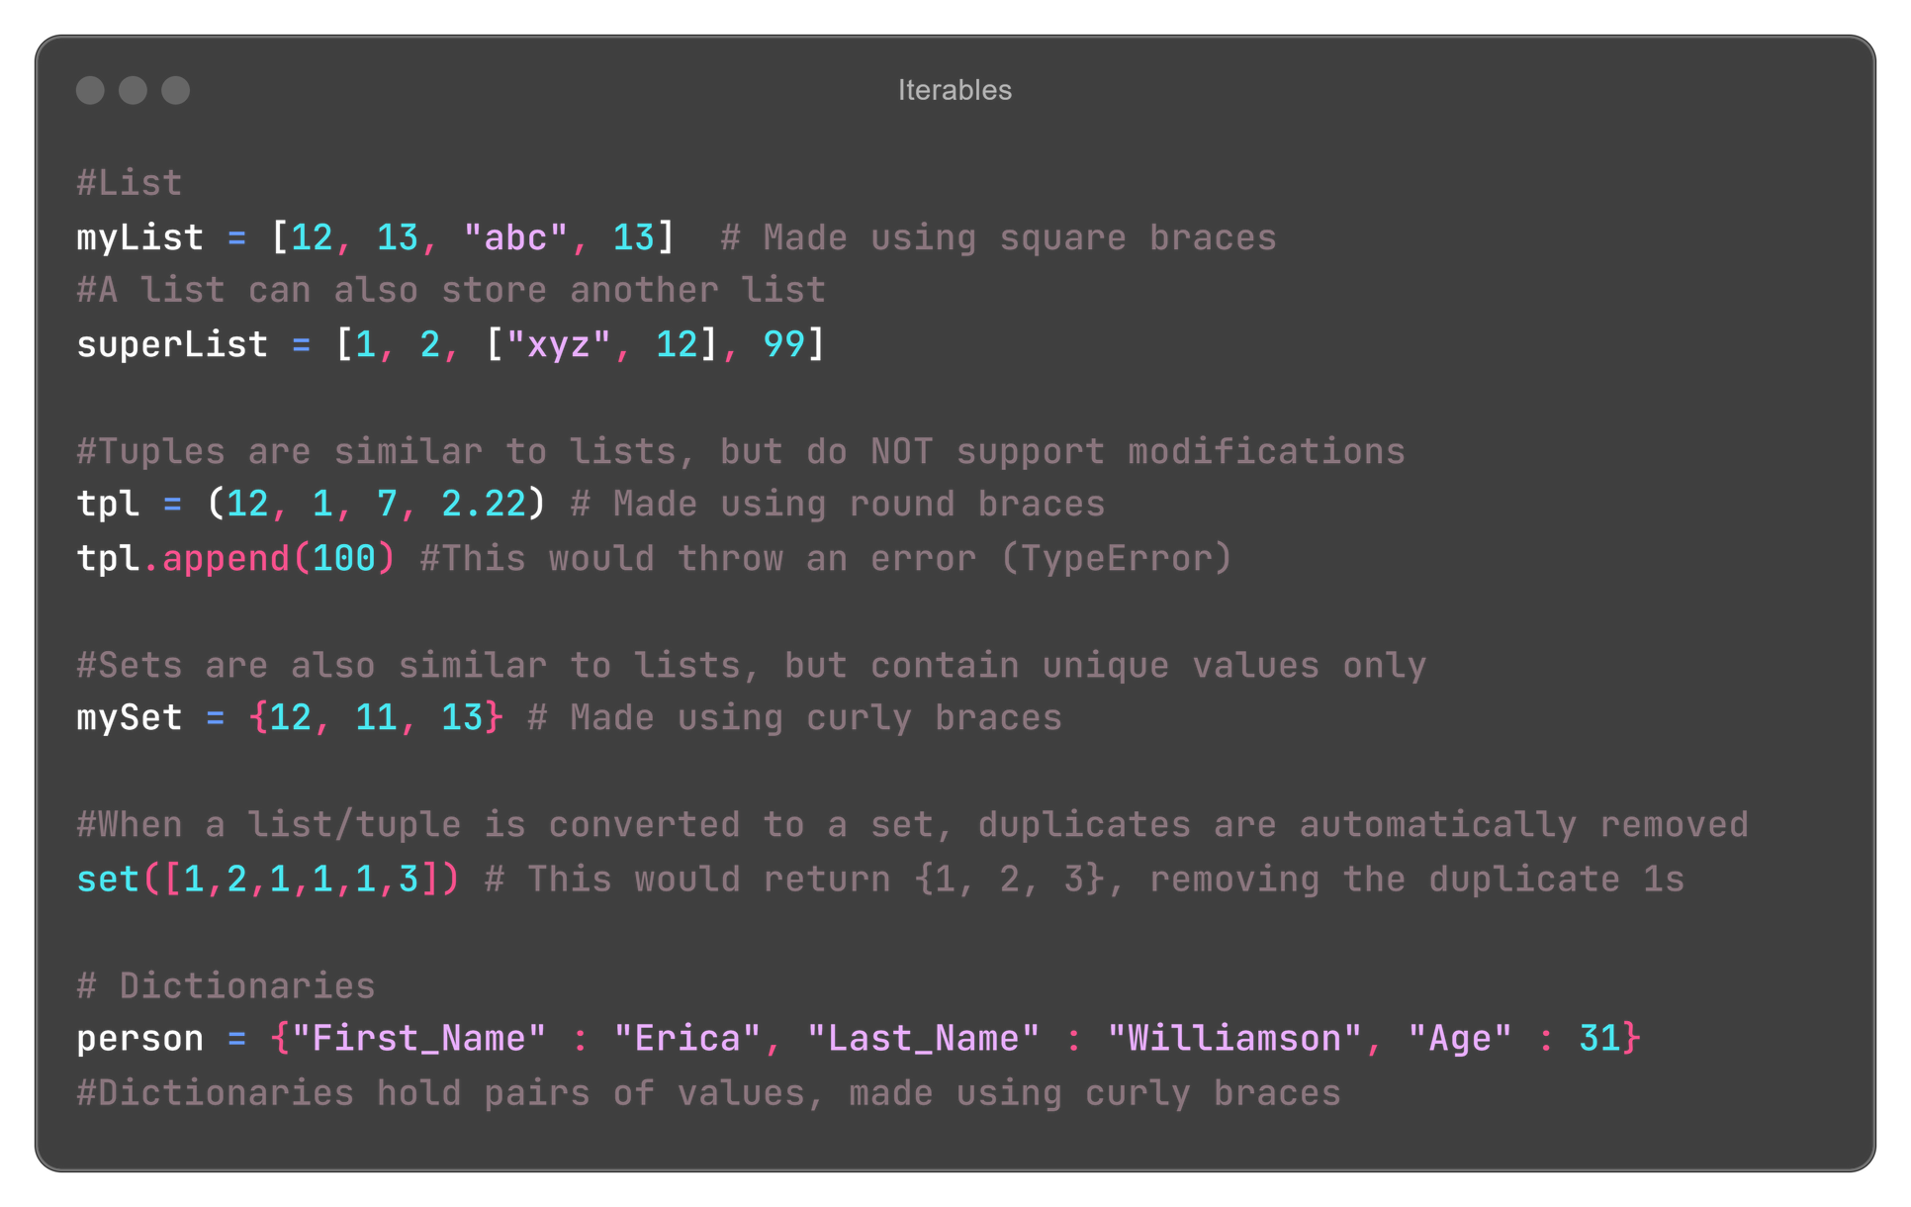
Iterables

Slide 27
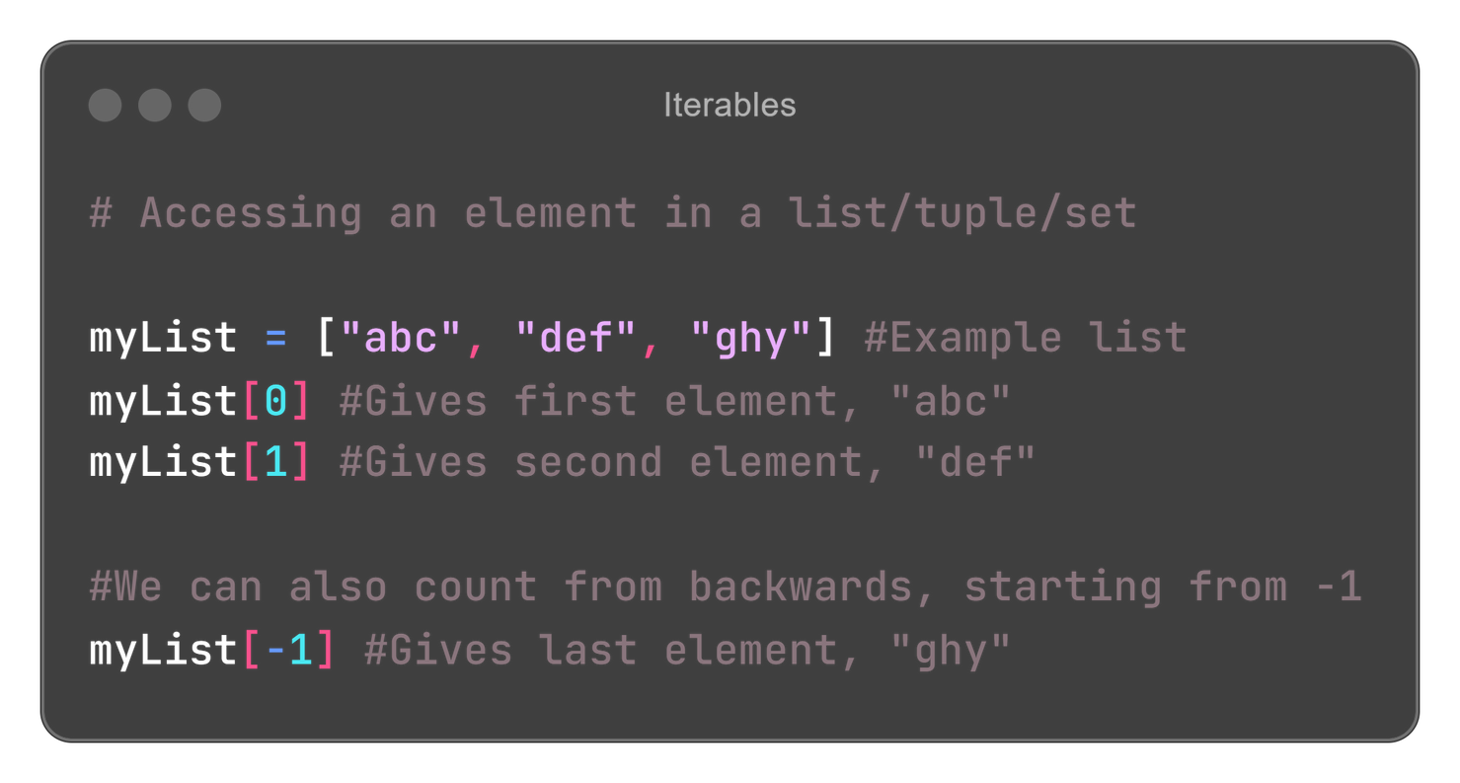
Accessing an element in an iterable is fairly simple
Iterables

Slide 28
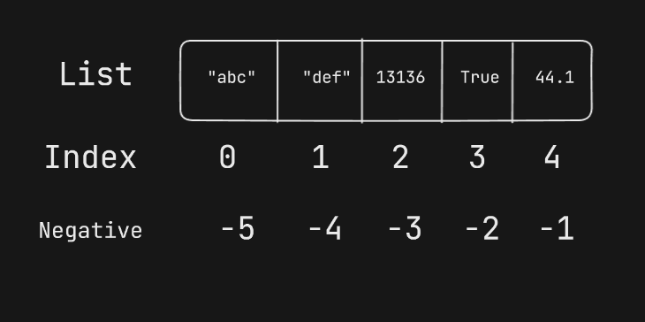
Accessing an element in an iterable is fairly simple
Iterables

Slide 29
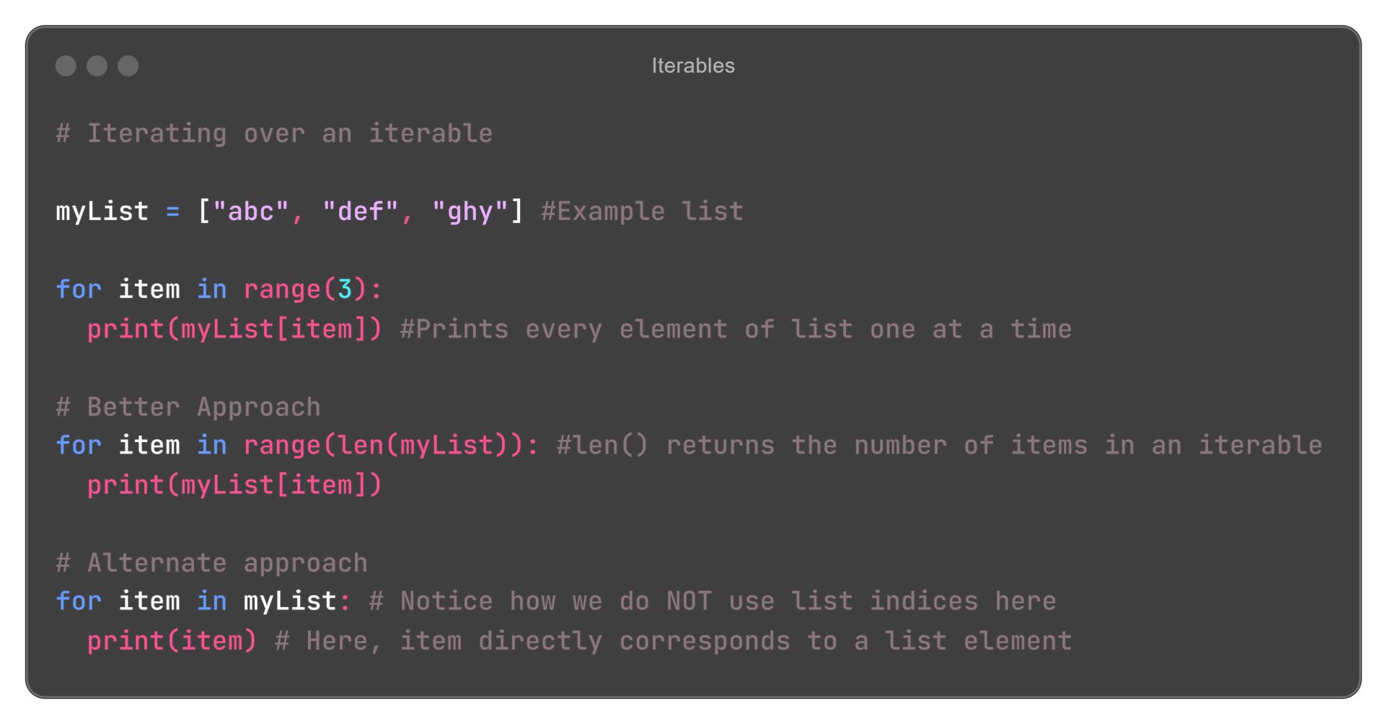
Iterables

Slide 30
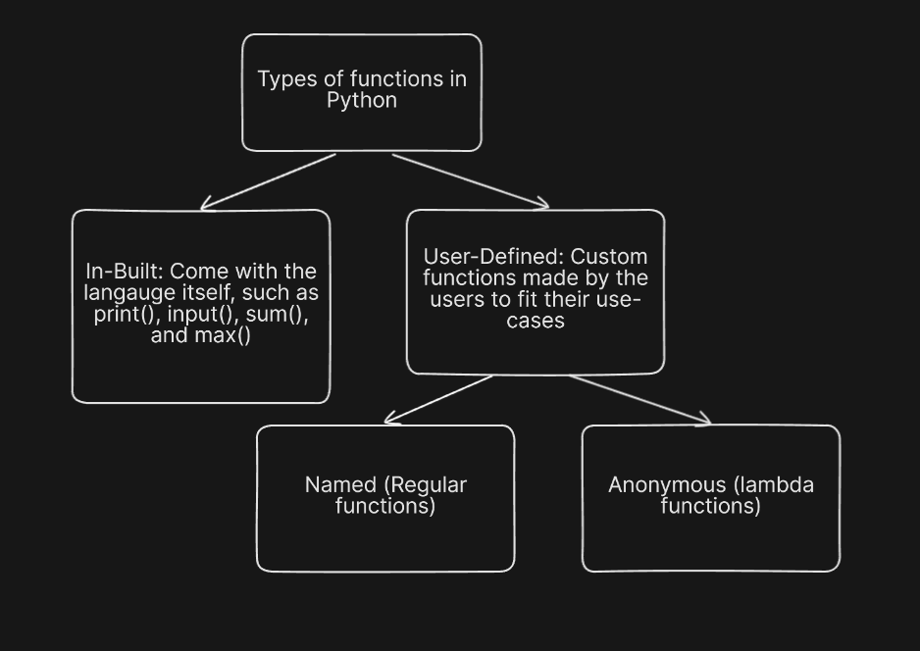
A function is a set of instructions that we can reuse again and again, to save us time and effort that would otherwise go in rewriting the same thing again and again.
Functions

Slide 31
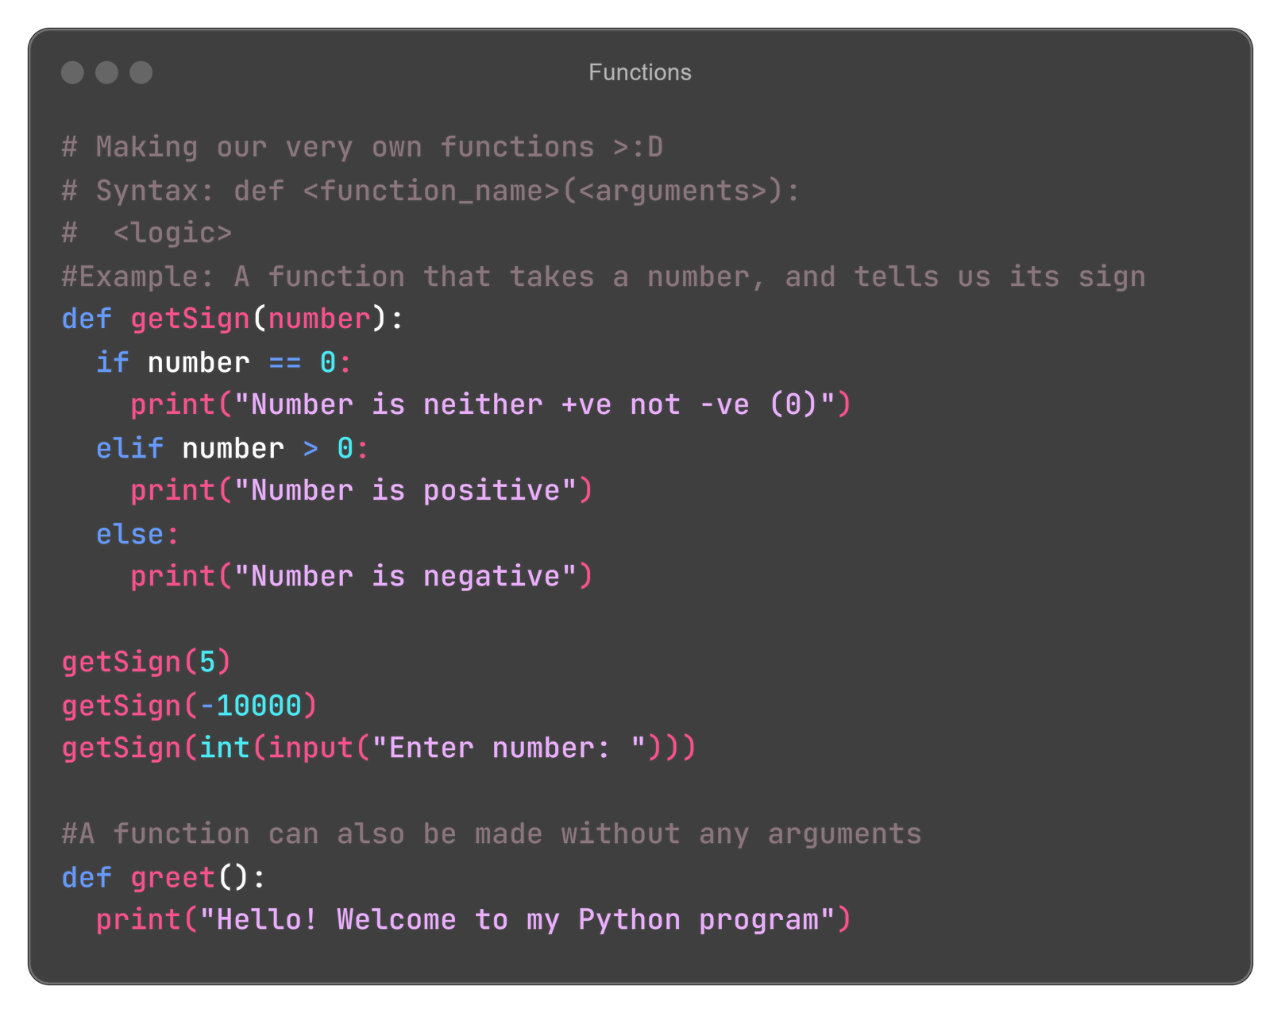
Functions

Slide 32
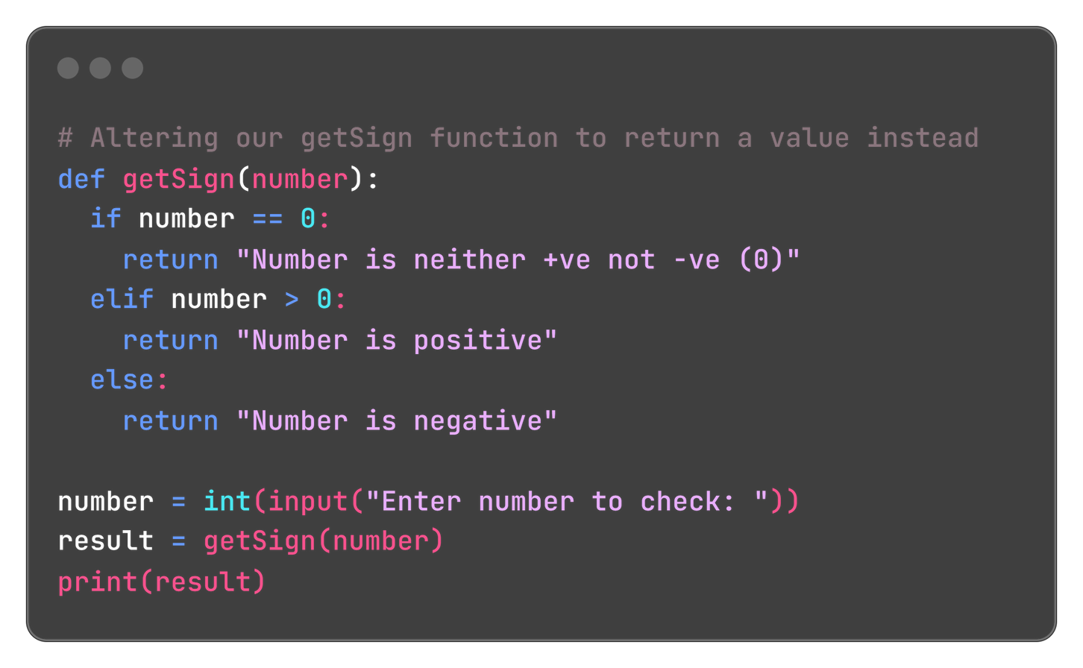
Return: The ‘return’ keyword in Python is used to define the value that a function gives once it’s done working.
In a more concise way, the value (if any) that a function returns to the place where it was called from originally.
Note: A function returns None by default.
Functions

Slide 33
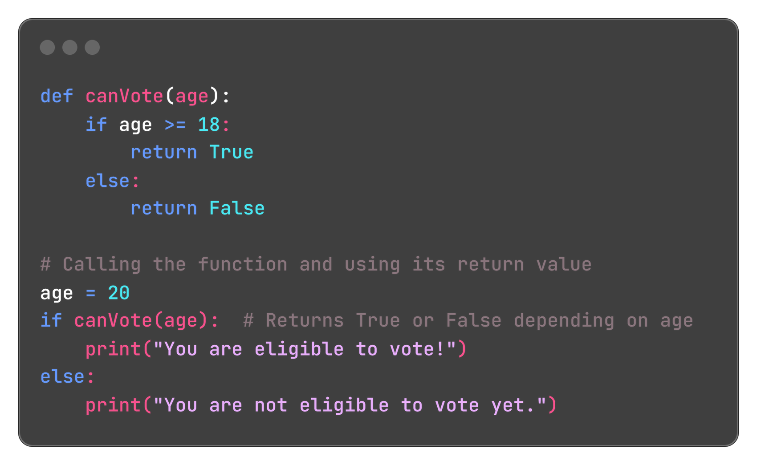
Functions

Slide 34
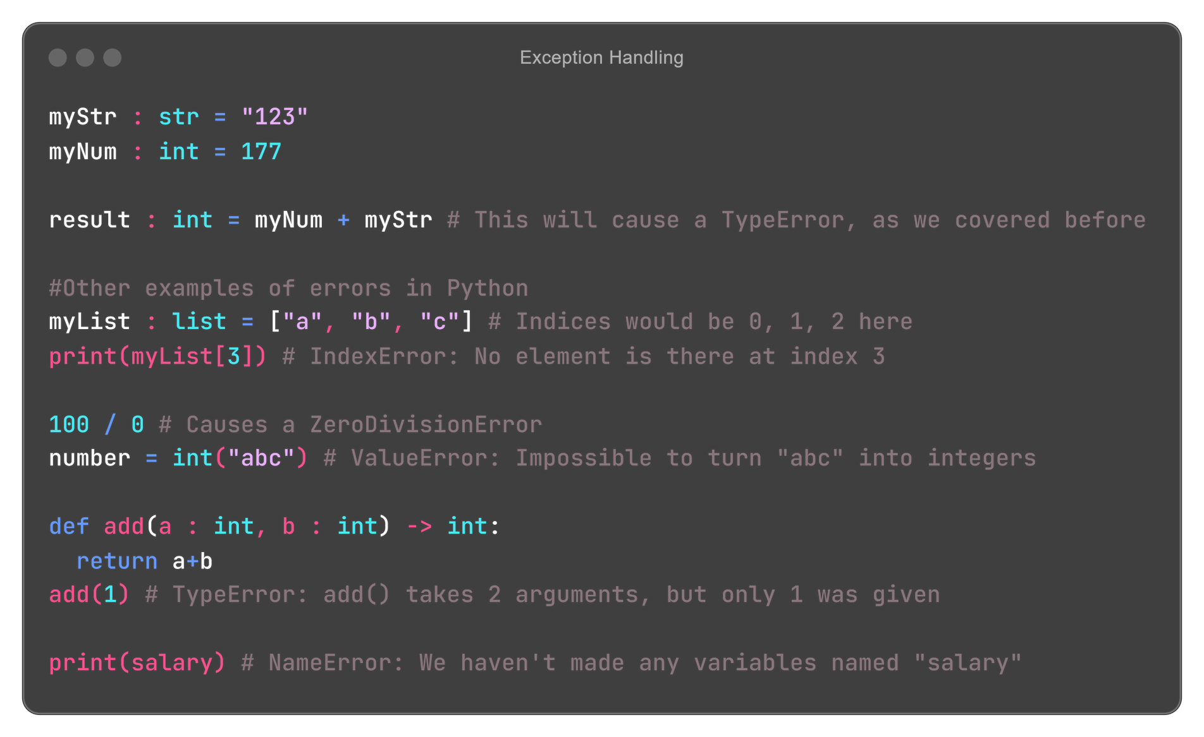
Exceptions

Slide 35
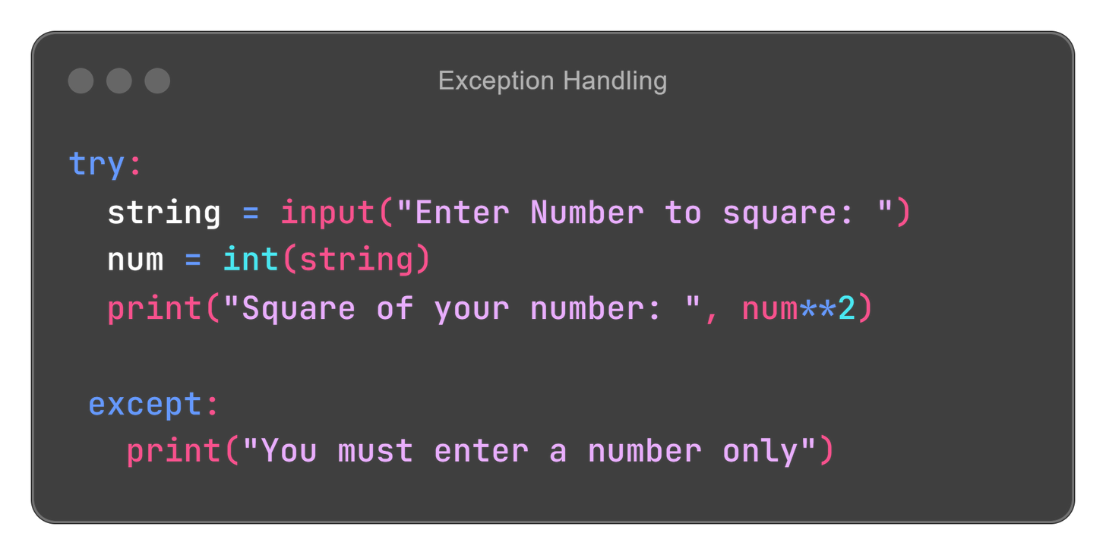
Exception handling in Python is a way to handle errors that occur during the execution of a program, without crashing the program. Instead of stopping when an error happens, you can "catch" the error and decide what to do next.
Exception
Handling

Slide 36
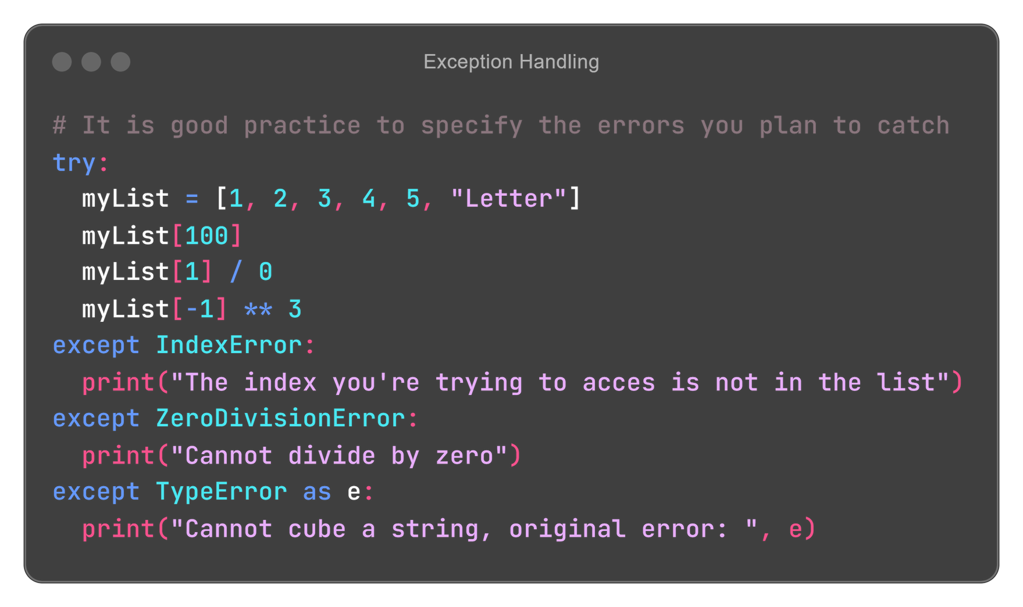
Exception Handling

Slide 37
Your Topic Goes Here
TEST
CONDITION
False
True
IF BLOCK
STATEMENTS AFTER
IF BLOCK

